Slide 1
Objective: To assist decision making when modifying a rainwater collection system.
How? Assessing the influence of operational variables in the probability of failure of the system.
Failure:
Water going out of the system
Volume of water going out of the system
Volume of water exceeding a threshold value

Slide 2
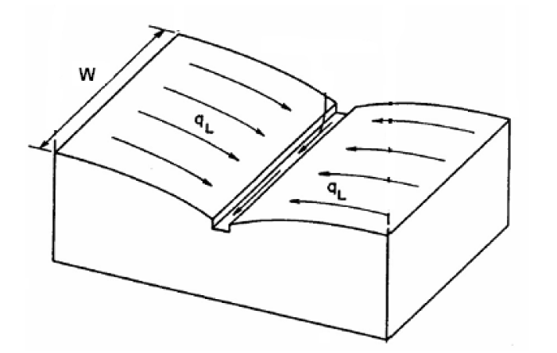
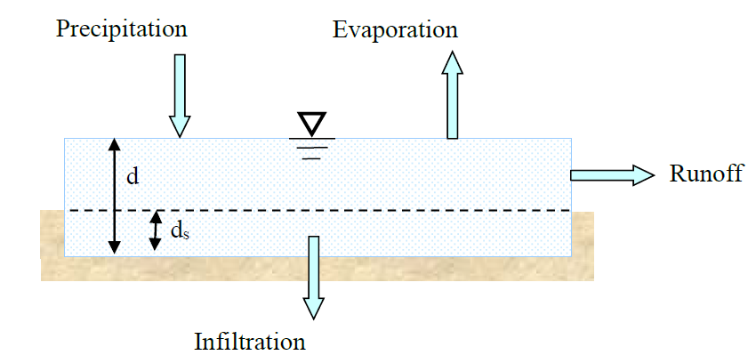
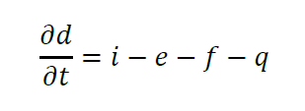
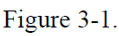
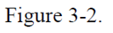
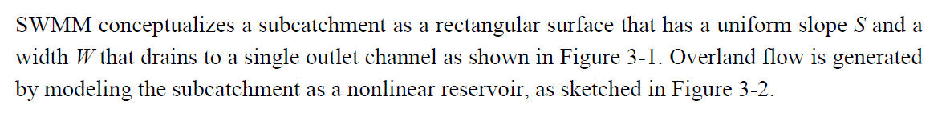
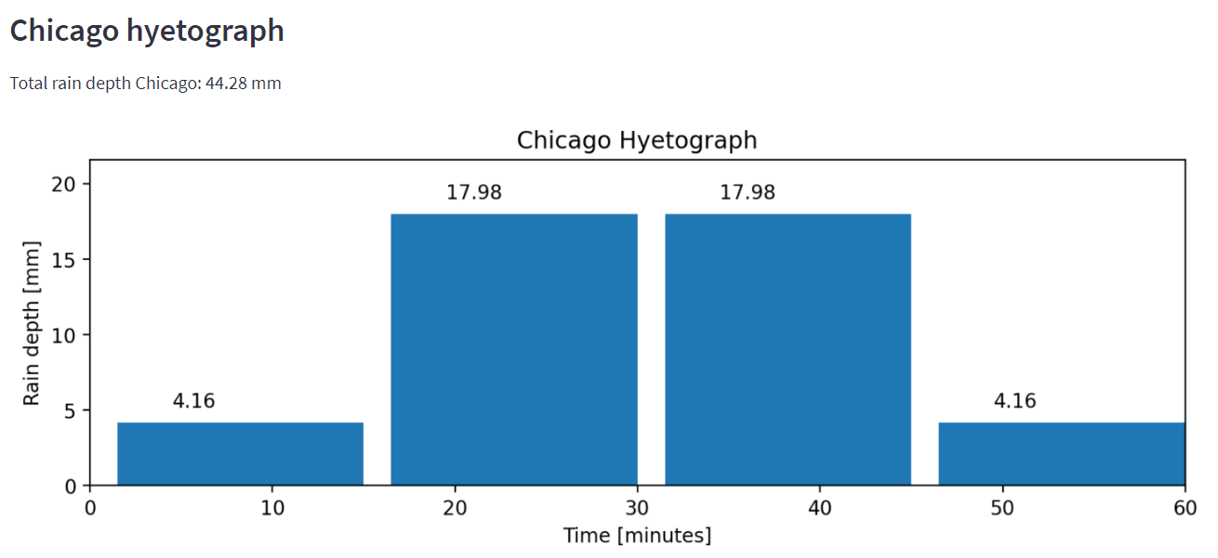
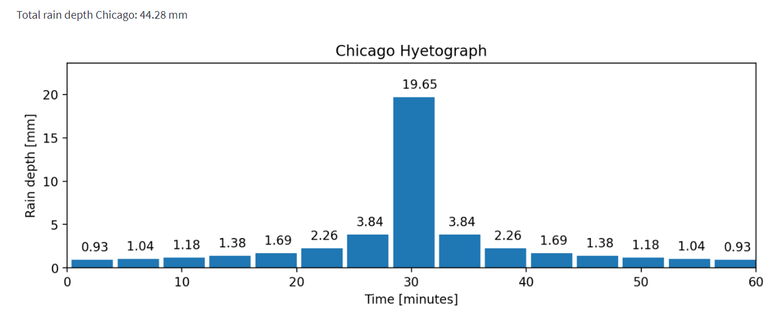
How does SWMM conceptualize the flow of water?
Precipitation = f(LSPP, T, hyetograph model, rain duration, and Δt_{hy})

Slide 3
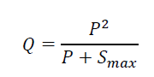
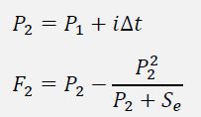
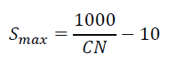
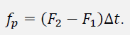
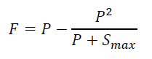
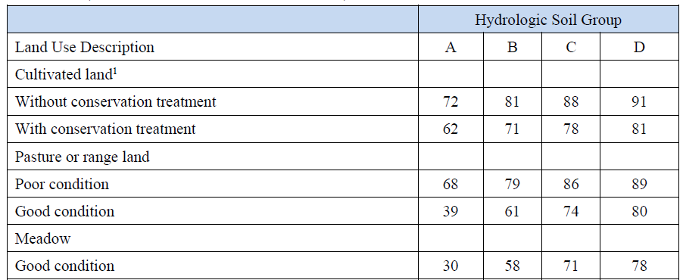
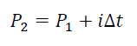
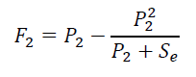
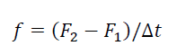
How does SWMM conceptualize the flow of water?
Infiltration = f(CN)
P₁ = 0, F₁ = 0
Compute cumulative rainfall and infiltration at the end of the time step:
Compute potential infiltration rate:
Large CN numbers are associated with less permeable areas

Slide 4
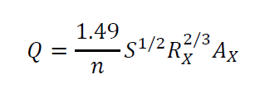
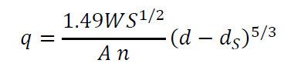
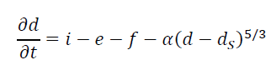
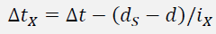
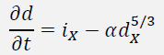
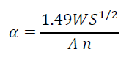
How does SWMM conceptualize the flow of water?
Surface Runoff = f(roughness surface, surface slope, area, width, depression storage)
For each subcatchment, retrieve its current precipitation rate i from the hyetograph.
For each subcatchment:
d_{a} = i*Δt + d
Determine the infiltration rate f using any method.
If f*Δt > d_{a}, then d = 0 and q = 0, otherwise compute rainfall excess i_{x} = i –f.
If i_{x} is not enough to fill d_{s} over the time step, then update d to d + i_{x} Δt and set q=0, otherwise solve mass balance diff. equation.
If at the beginning of the time step d<ds and the rainfall excess is positive, then compute the time step Δt_{x} during which the depth will exceed d_{s} and set d = d_{s}.
Solve: for d over time step Δt_{x}. dx = d-ds.
Compute the runoff per unit area q = αd^5/3 and total runoff Q = q*A
“In general, however, shifting hydrograph peaks in time is difficult to achieve through adjustment of subcatchment flow routing parameters. The time distribution of runoff is by far most sensitive to the time distribution of rainfall.”

Slide 5
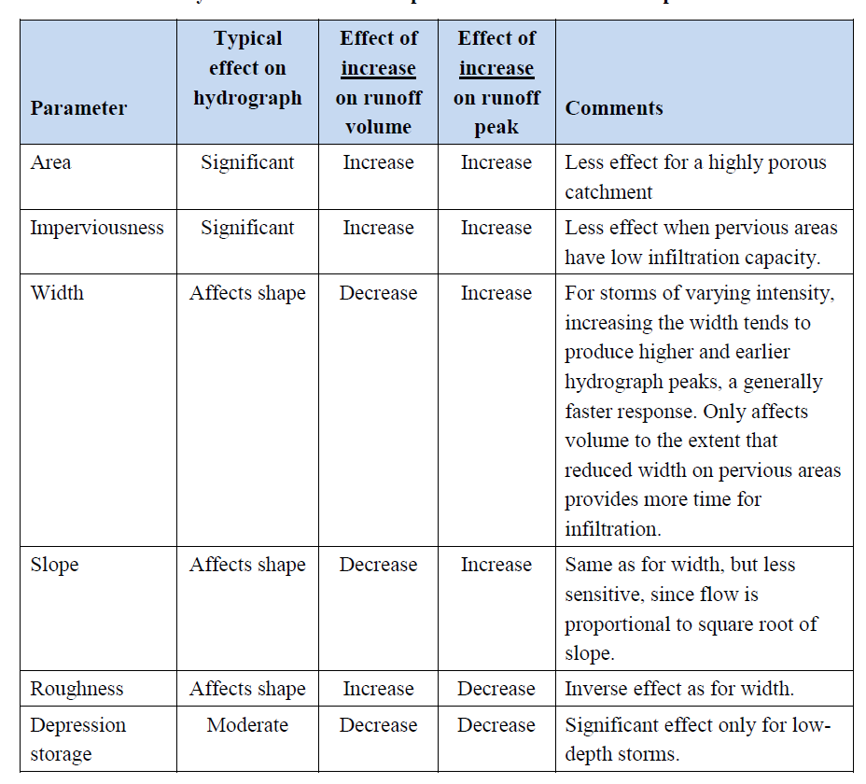

Slide 6
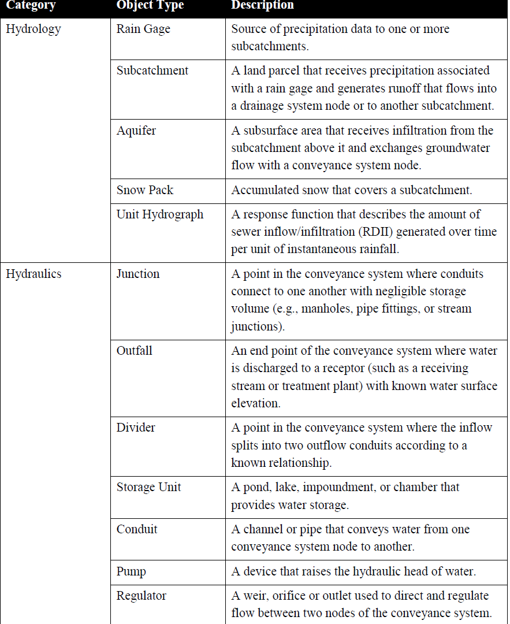
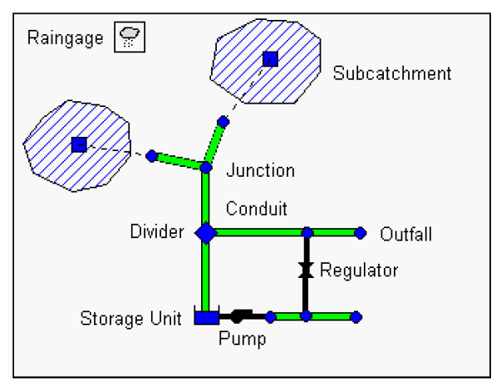
How does SWMM conceptualize the flow of water?

Slide 7
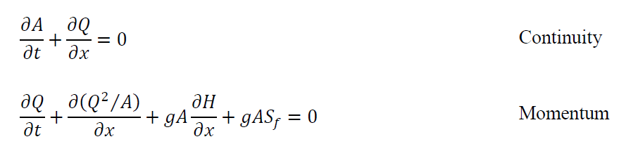
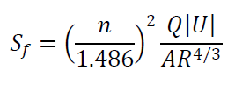
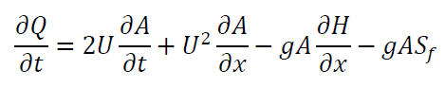
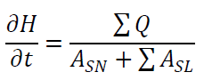
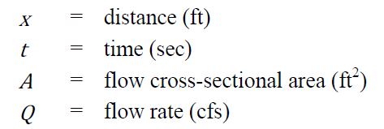
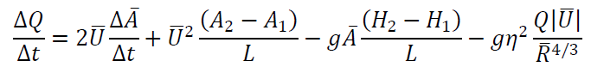
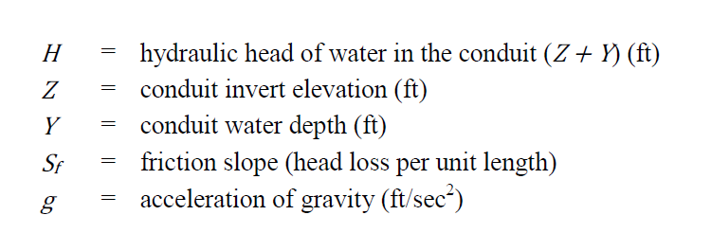
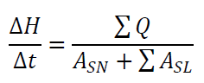
How does SWMM conceptualize the flow of water?
Network flow = f(node elevation, node depth, conduit length, conduit roughness, conduit diameter)
Momentum Equation for conduits
Head variation at nodes
Finite difference approximation of equations

Slide 8
Objective: To assist decision making when modifying a rainwater collection system.
How? Assessing the influence of operational variables in the probability of failure of the system
LSPP - Chicago
CN
Mass balance + Manning
Continuity/Dynamic wave
Precipitation:
LSPP pars
T
Rain duration
Δt_{hy}
r
Infiltration:
CN
Surface Runoff:
Roughness surface
Surface slope
Area SC
Width SC
Depression storage
Network flow:
Node elevation
Node depth
Conduit length
Conduit roughness
Conduit diameter
Fixed quantities: Return period, rain duration, Δt_{hy}, r, surface slope, area SC, width SC, depression storage, node elevation, node depth, conduit lenght
Stochastic quantities: LSPP parameters, roughness surface, depression storage
Operational quantities: CN, conduit roughness, conduit diameter
Identify areas that can be interesting for the study. Does it worth to have a dummy case?

Slide 9
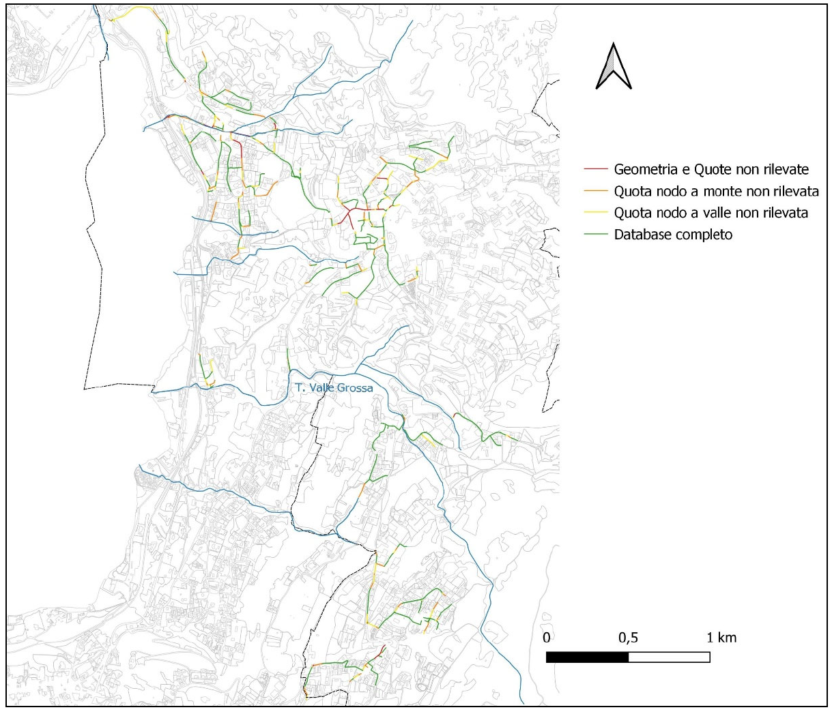
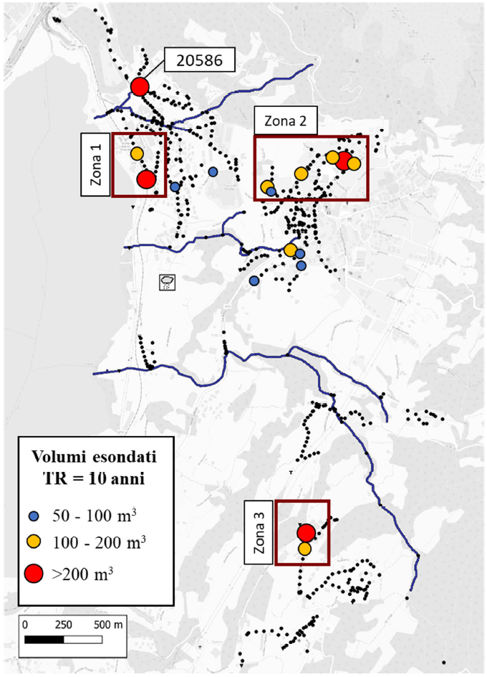

Slide 10
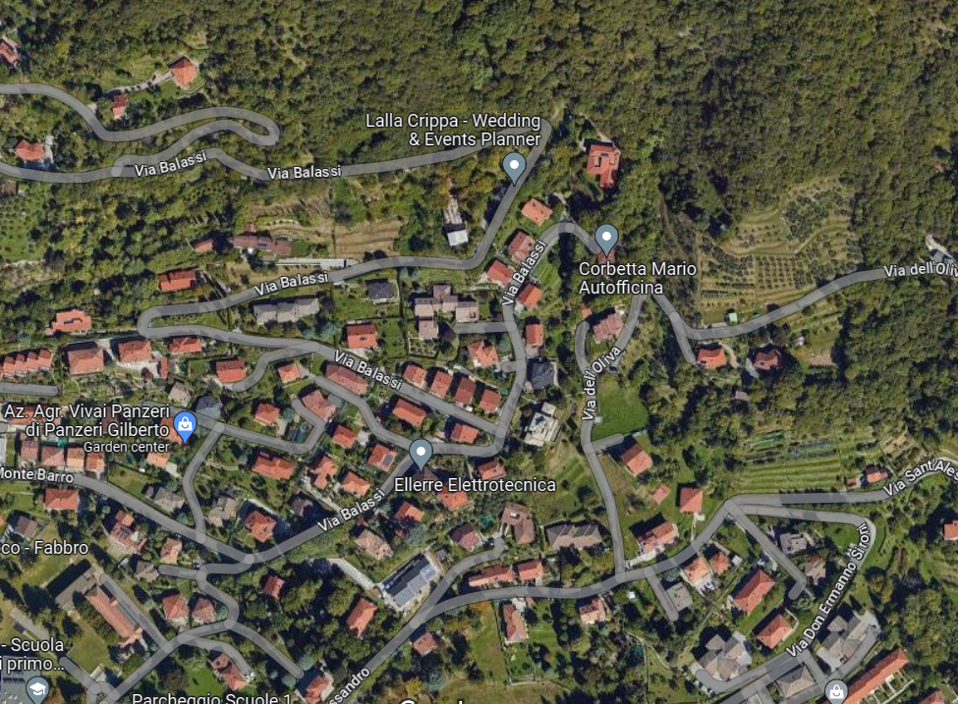
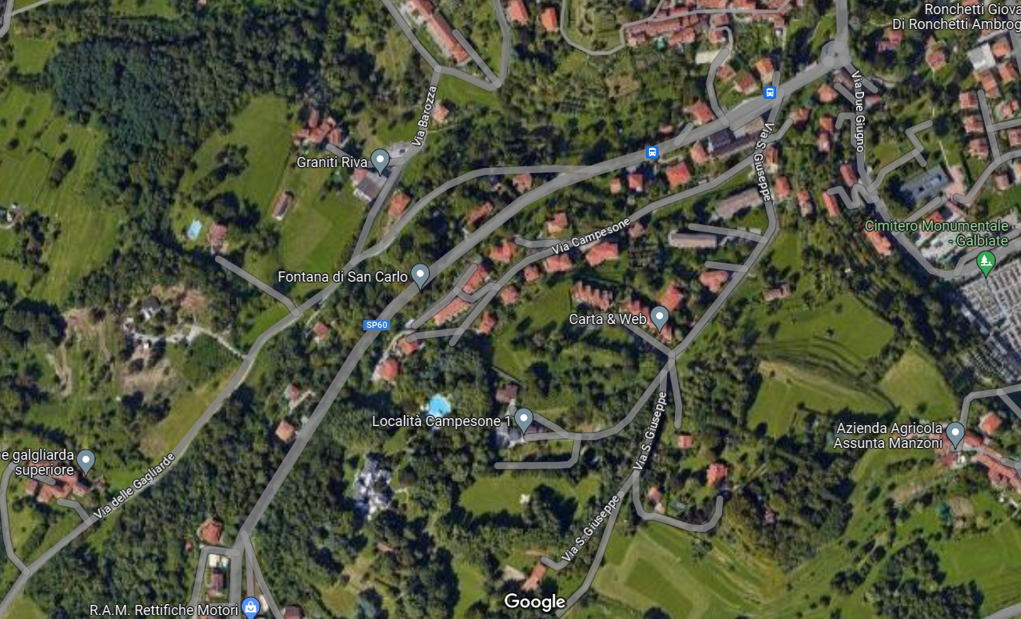

Slide 11
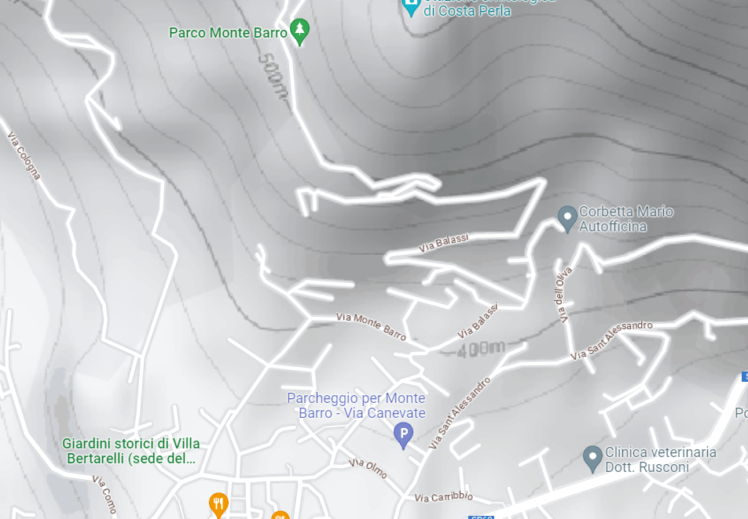
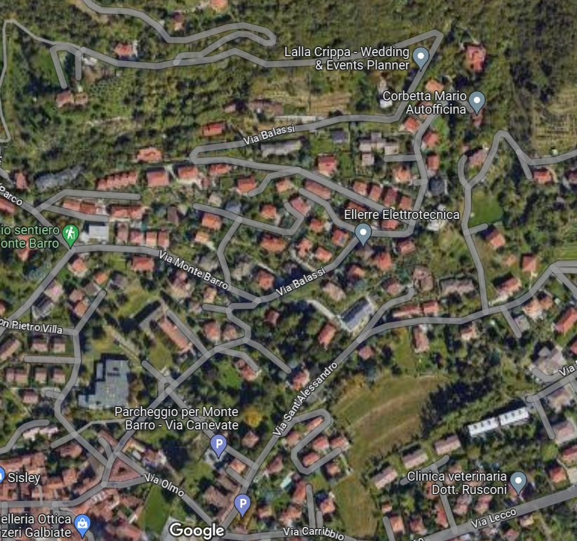
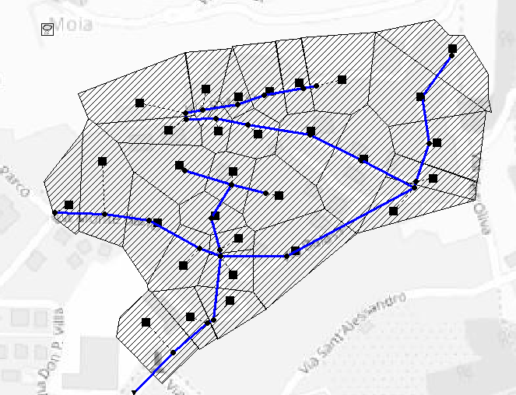
Stochastic Quantities:
LSPP pars x5
Roughness of surface
30 subcatchments
30 conduits
30 joints
1 outfall
3 critical nodes
Operational Quantities:
CN x 30
Conduit diameter x 30
Conduit roughness x30

Slide 12
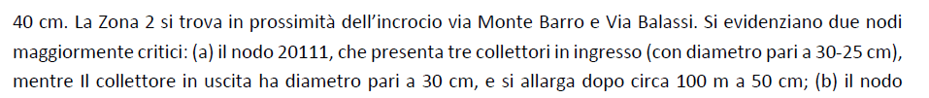
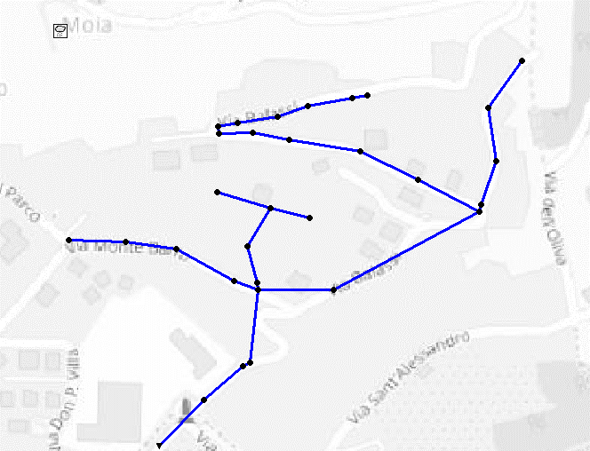
20123
178 m³
20110
106 m³
20111
286 m³
Either this or any other study case that we choose must be re-implemented paying attention to the subcatchment area associated with each node.

Slide 13
4
3
Define ranges of variability/parameter values
2
Create an enhanced version of the model
1
Ask to Lario Reti the latest dataset that they have of the network elements in this area? NO!
Define operational variables
This version should be easy to iterate

Slide 14
AFTER 06-09-2023
The model has been improved so that the subcatchments reflect better the real conditions of the study area.
We have advanced on the elaboration of the code that allows to run the model from a script file.
I propose some operational quantities and I suggest to do a prior sensitivity analysis.

Slide 15
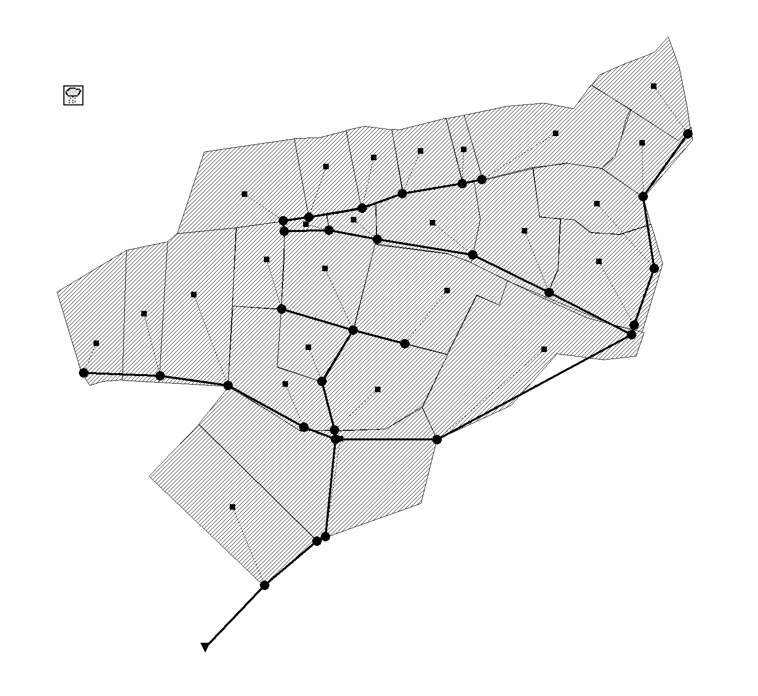
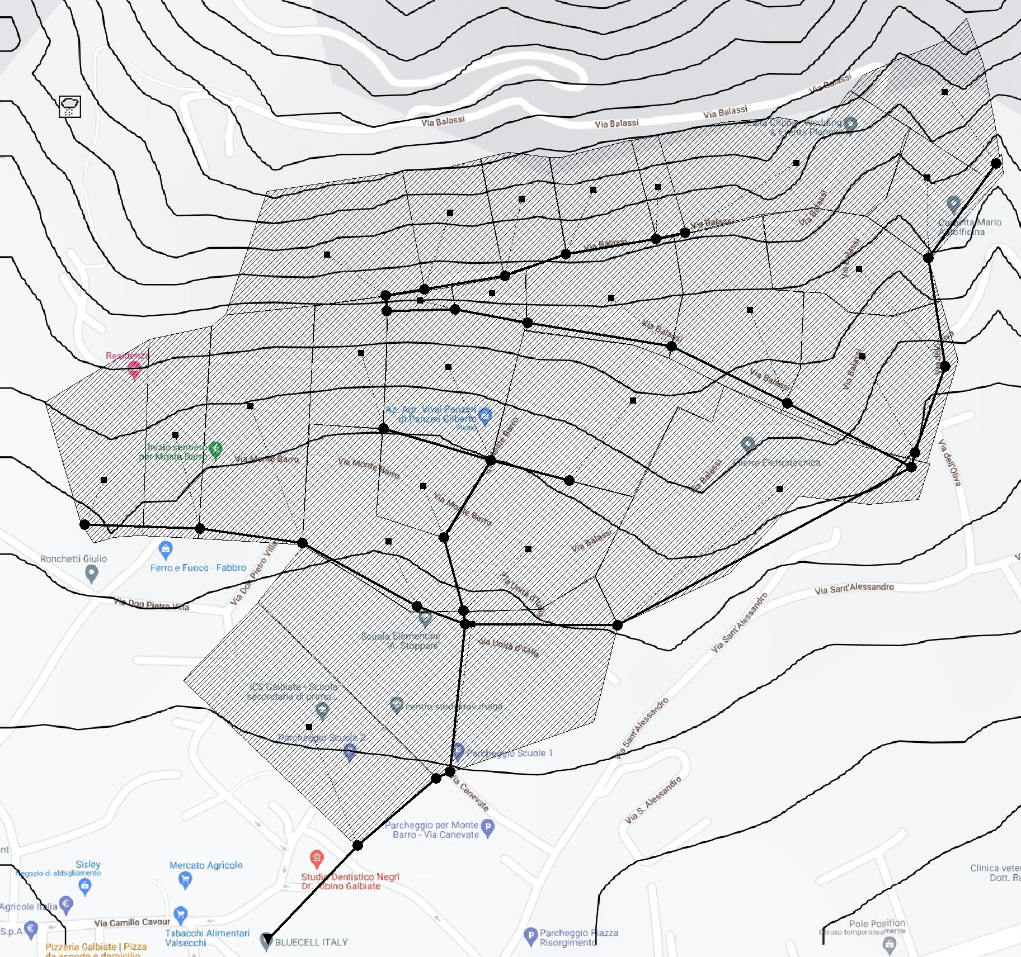
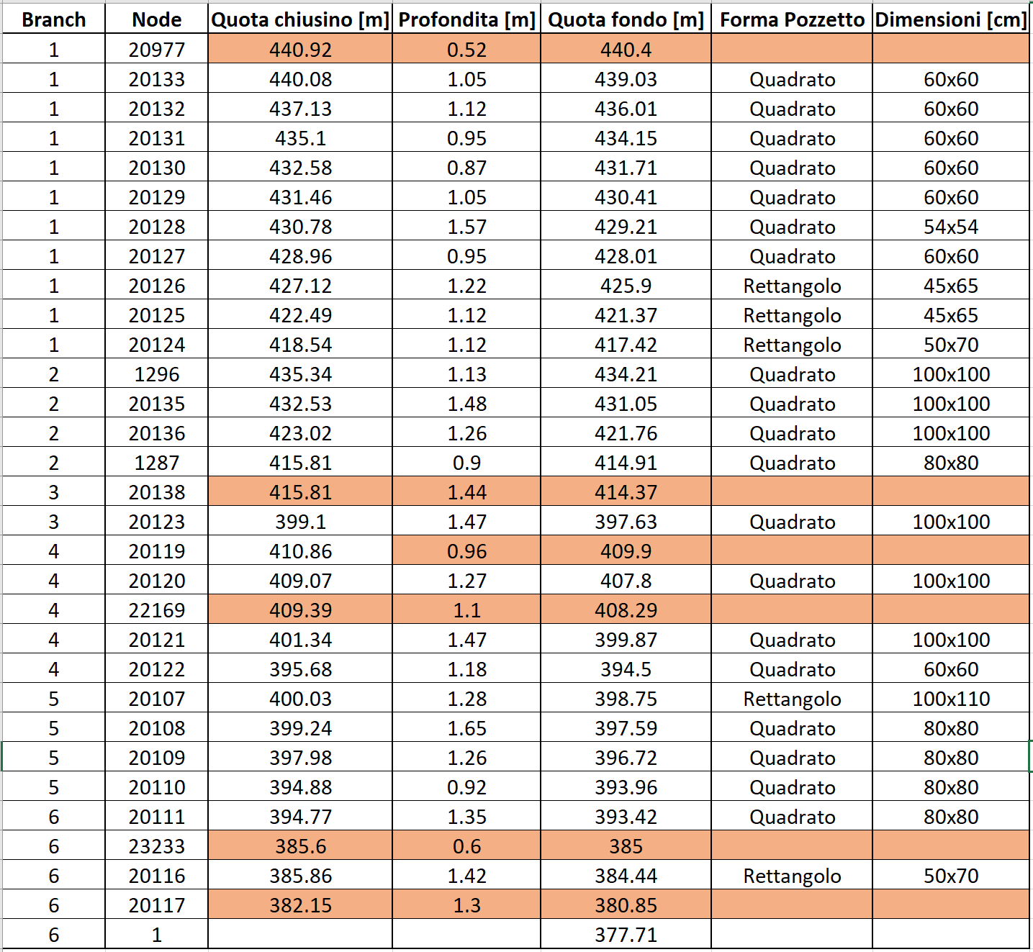
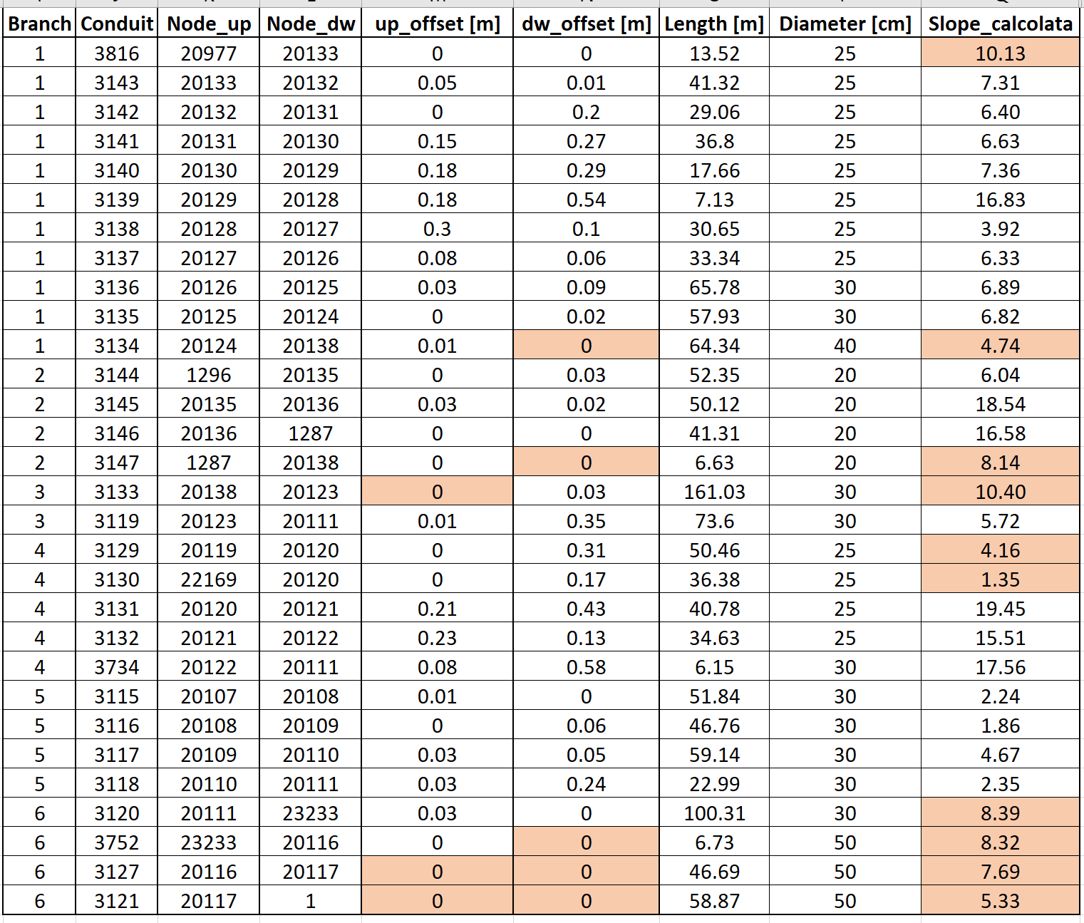
Branch 1
Branch 2
Subcatchments are defined on the basis of the DEM. The DEM original resolution is 20m. It was interpolated to a resolution of 5m.
Branch 4
Branch 5
Branch 3
Branch 6
Highlighted cells refer to data that was not measured in field campaigns, so it had to be estimated.

Slide 16
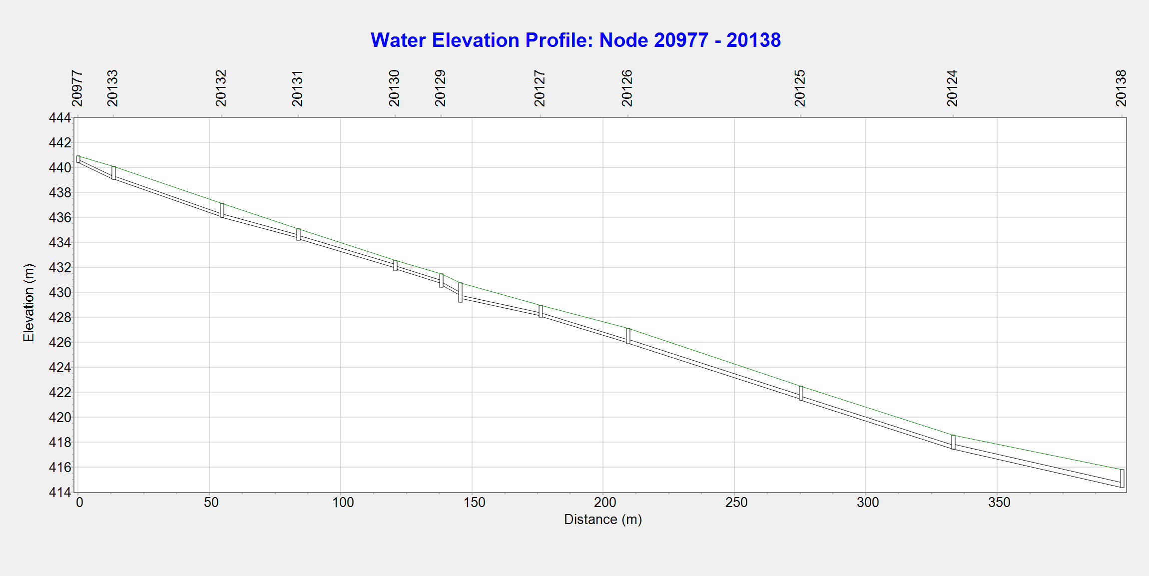
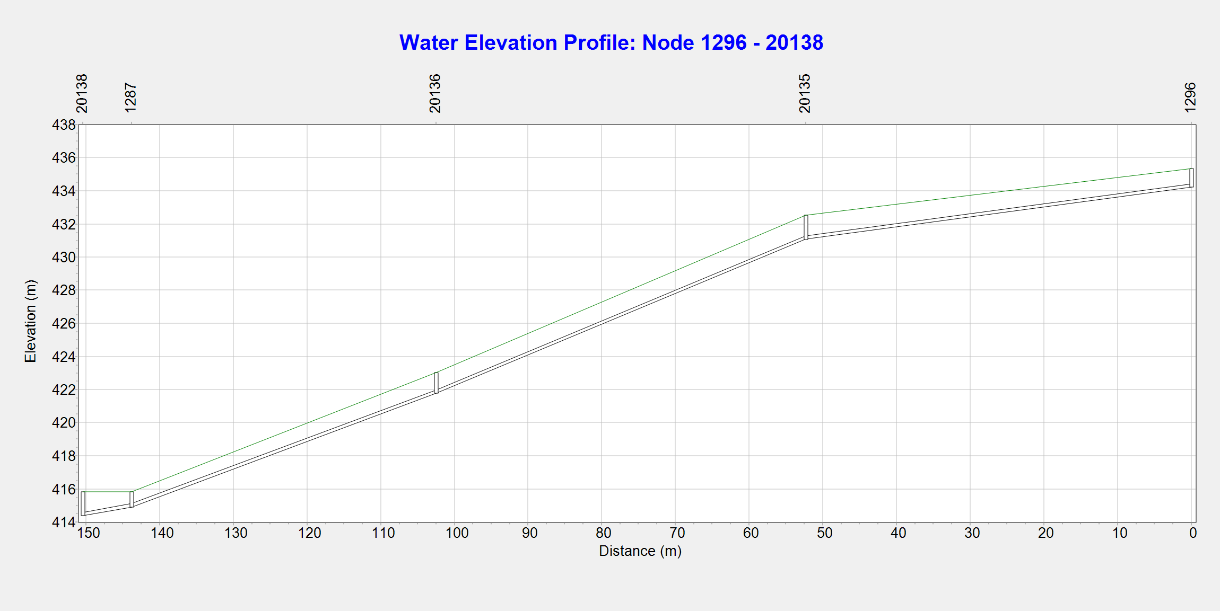
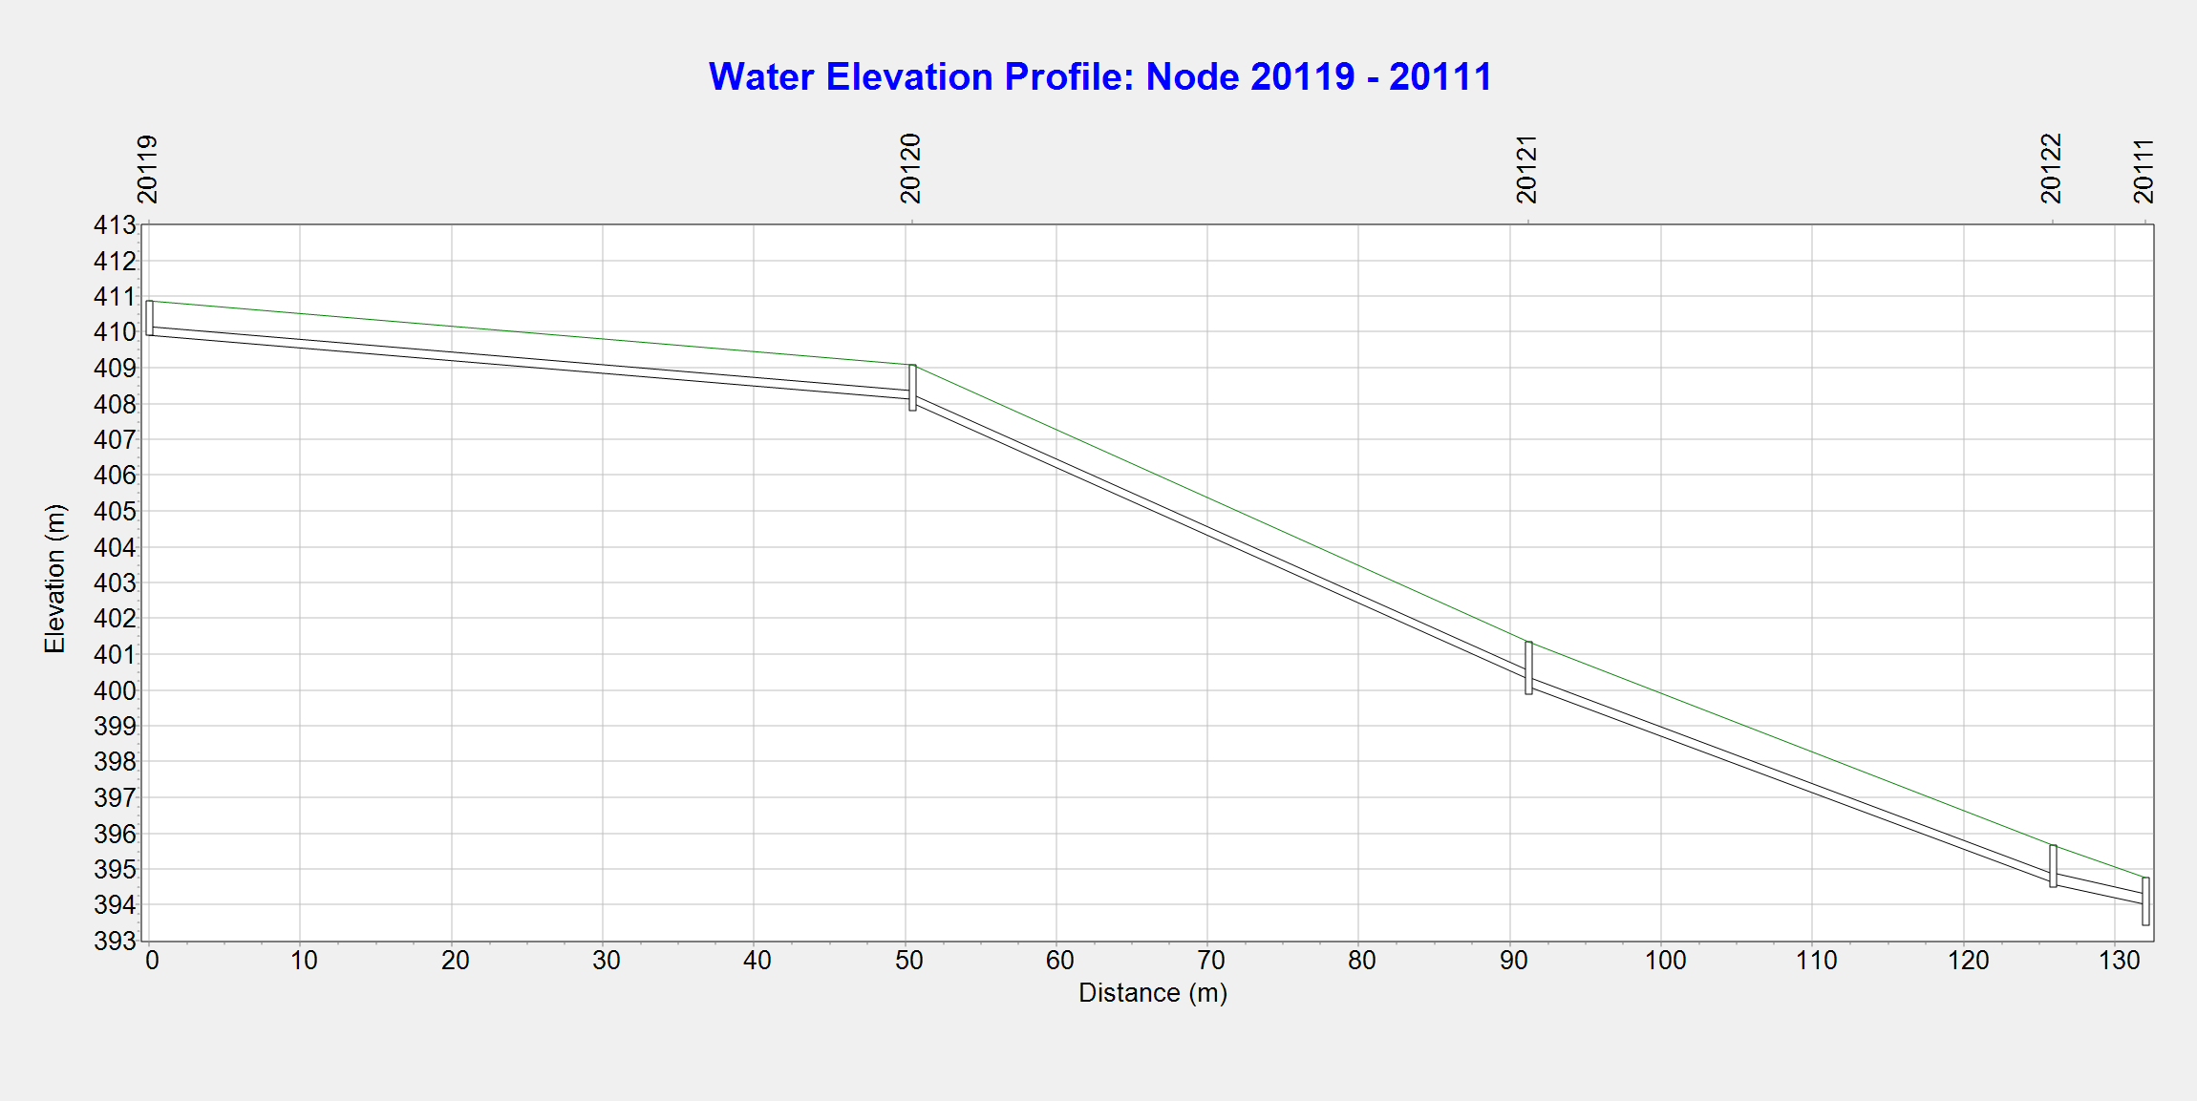





Slide 17





Diameter
Roughness
Total flooded volume 540
Slope
Link capacity
21 m³
139 m³
96 m³
264 m³

Slide 18




Total volume 540
Slope
Area
Infiltration [mm/h]
Runoff [CMS]
CN numbers generally range between 80 and 90
* Large CN numbers are associated with less permeable areas

Slide 19
Stochastic quantities:
a1 = []
n = []
α = []
ε = []
κ = []
Roughness surface = []
Depression storage = []
Operational quantity 1:
Diameter [m]
0.3
0.4
0.5
0.6
LSPP pars.
Operational quantity 3:
CN values
Decrease CN values 5 units.
Decrease CN values 10 units.
Decrease CN values 15 units.
Operational quantity 2:
Manning rough. Coeff.
0.009 (PVC)
0.014 (CS)
Blue circles indicate which conduits and which subcatchments will be modified by the operational variables.
Note that all the elements will be modified at once in each realization. e.g., The diameter of the conduits in a given realization will be the same for all conduits.
Still, we have too many parameters!!!
We can do a sensitivity analysis of the hyetograms to identify relevant parameters and reduce computational cost of the analysis.
We have to define ranges of variability for all stochastic quantities.
Notes:
https://www.oppo.it/materiali/tubi_raccordi/tubi_cemento_condotte.htm

